Slide 1

Medication errors
National Capacity Building Program on Patient Safety in India
Dr. Gagandeep Kwatra
Additional Professor, Pharmacology
AIIMS, Bathinda
18 December 2024

Slide 2
Introduction: the burden of unsafe care
Institute of Medicine Report , USA: estimated that 44 000–98 000 medical error deaths occur annually .*
There is one medication error/hospitalized patient /day and 1.5 million preventable adverse drug events per year. **
Medication-related harm may be the cause of about 1/10th of hospitalizations and about 1/5th of patients admitted to hospitals experience medication-related harm .
In developing countries, the probability of patients being harmed in hospitals is higher than it is in industrialized nations.
*Kohn LT, Corrigan JM, Donaldson MS, eds. To err is human: building a safer health system. 1999.
**Institute of Medicine. Preventing medication errors. Report brief. Washington, DC, National Academies Press, 2006.

Slide 3
The burden of unsafe care
The pooled prevalence of preventable medication-related harm in all 100 studies was 5% (1 in 20 patients). *
One fourth of the harm was severe or potentially life-threatening.
Geographical distribution of preventable medication-related harm: The prevalence of preventable medication-related harm was 7% in 30 studies in LMICs and 4% (3–5%, one in 25 patients) in 70 studies in HICs.
*Global burden of preventable medication-related harm in health care: a systematic review. Geneva: World Health Organization; 2023

Slide 4
The burden of unsafe care
Medication errors may result in additional hospitalization, litigation costs, infections acquired in hospitals, lost income and disability.
Such errors negatively affect the patients’ confidence in the healthcare system.
They are also very costly: to the healthcare systems, patients and their families, and healthcare workers.
Studies show that additional hospitalization, litigation costs, infections acquired in hospitals, lost income, disability and medical expenses have cost some countries between US$ 6 billion and US$ 29 billion per year.

Slide 5
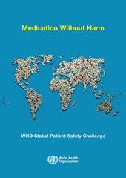
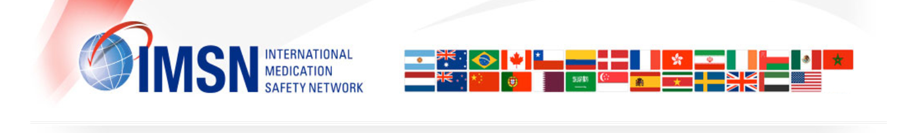
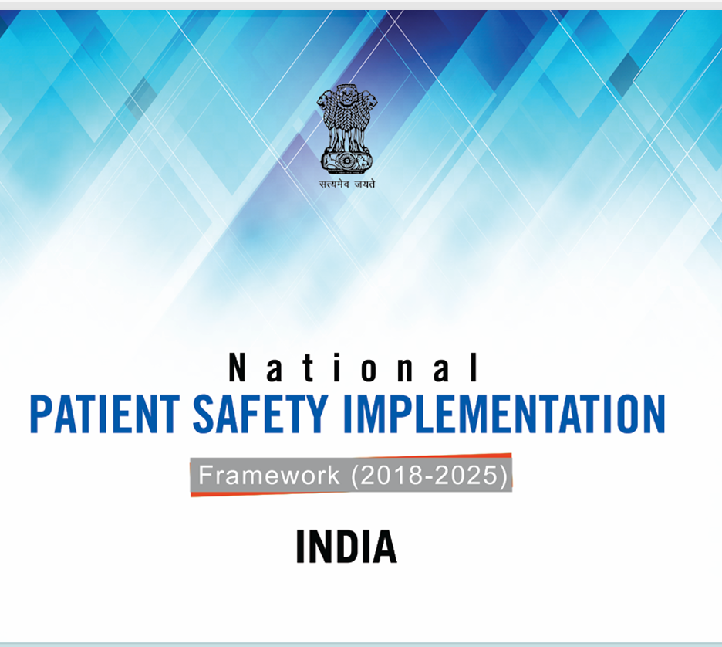

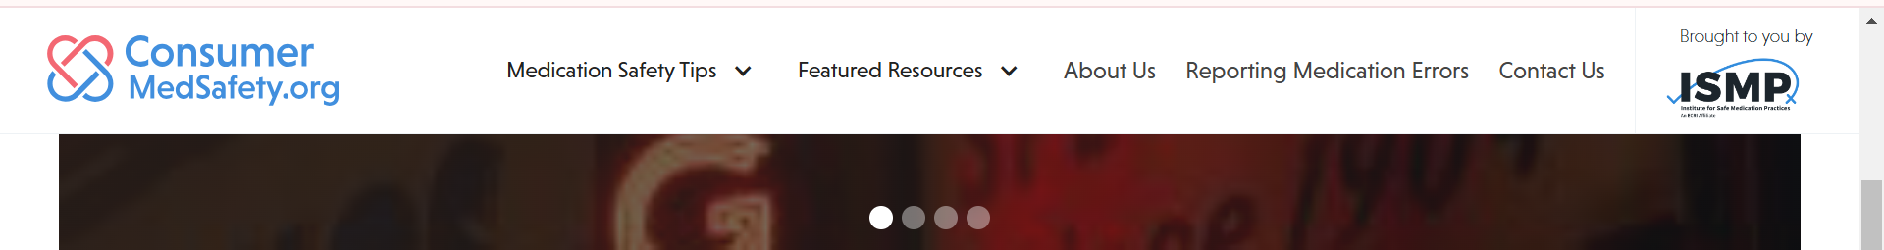
Patient and medication safety initiatives

Slide 6
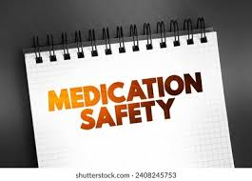
Session Outline
Define medication errors.
Explore how medication errors happen.
Measures to prevent medication errors.
Use of technology to prevent medication errors.
Reporting of medication errors.

Slide 7
Medication Error
"A medication error is any preventable event that may cause or lead to inappropriate medication use or patient harm while the medication is in the control of the health care professional, patient, or consumer.
Such events may be related to professional practice, health care products, procedures, and systems, including prescribing, order communication, product labeling, packaging, and nomenclature, compounding, dispensing, distribution, administration, education, monitoring, and use.“
National Coordinating Council for Medication Error Reporting and Prevention

Slide 8
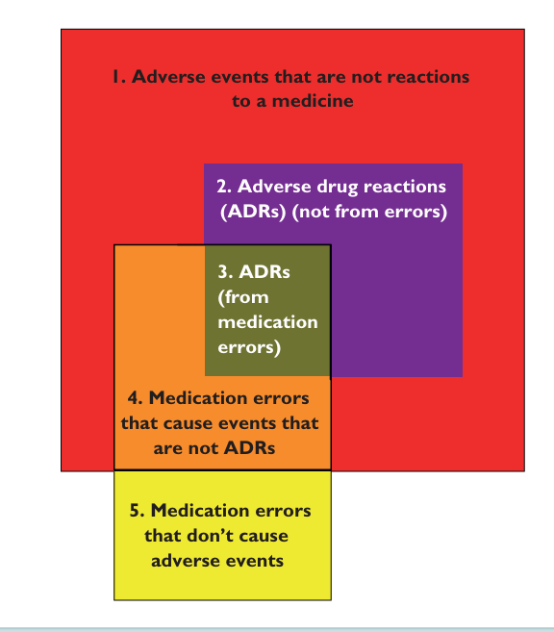
Medication errors, adverse events and adverse drug reactions

Slide 9
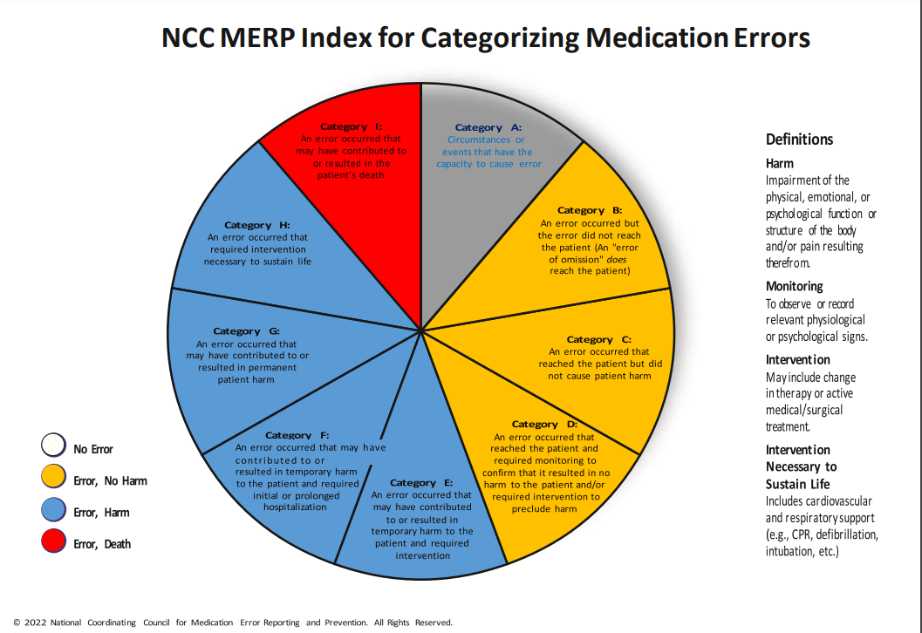

Slide 10
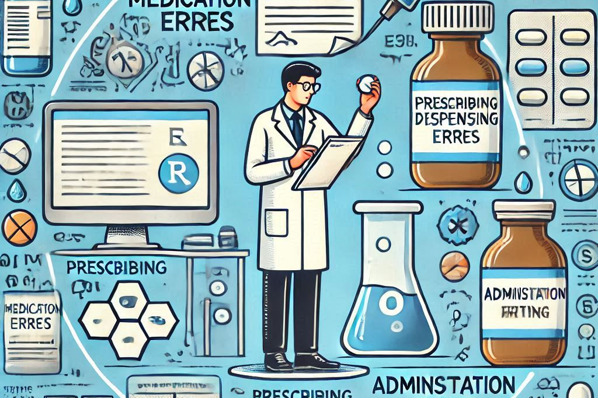
How do medication errors occur?

Slide 11
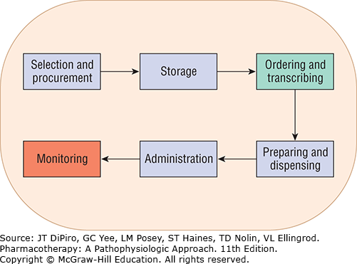
Dispensing
Administration
Prescribing
Monitoring
Medication-use process. (Data from ASHP guidelines on preventing medication errors in hospitals. Am J Hosp Pharm, 1993;50:305–314.)

Slide 12
Medication errors can occur in:
Selection of a medicine—irrational, inappropriate, and ineffective prescribing, overprescribing; under-prescribing and prescription errors, including illegibility.
Manufacturing the formulation to be used—wrong strength, contaminants or adulterants, wrong or misleading packaging;
Dispensing -wrong drug, wrong formulation, wrong label;
Administering or taking the drug—wrong dose, wrong route, wrong frequency, wrong duration;
Monitoring therapy—failure to monitor for safety, alter therapy when required, or stopping the therapy at course completion.

Slide 13
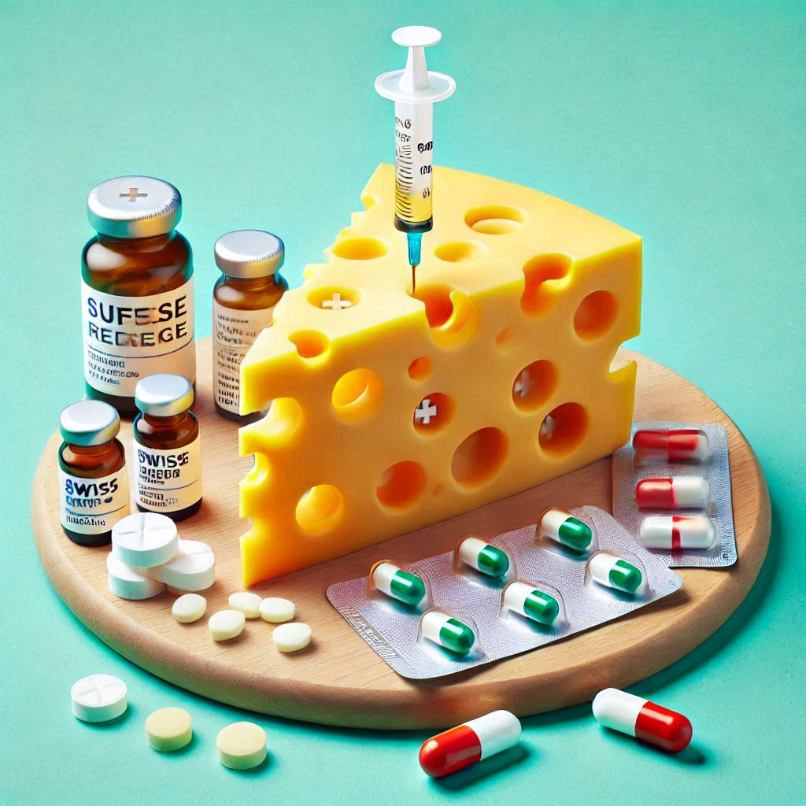
Why do medication errors happen?

Slide 14
Contributory factors for medication errors
Inexperienced personnel
Under-staffing
Improper medicine storage
LASA drugs
Ambiguous labelling
Administration errors
Lack of diagnostic data
Lack of safety culture
Poorly designed workflow
Multitasking
Distractions
Fatigue
Inadequate training
Illness
Drugs
High risk medications

Slide 15

Some patients are more vulnerable…….
Patients taking multiple medications
Older patients
Children and babies
Those with memory problems ( eg Alzheimer’s disease)
Patients undergoing high risk surgeries
Pregnant and lactating women
Patients who cannot communicate well

Slide 16
Planning for Safe Medication Practices
Safe medication practices begin with placing medication safety as an organizational and departmental priority, and implementing a system that will support these practices.

Slide 17
Key supporting elements
A culture of safety built on principles of just culture that is supported at all levels of the organization
System-based approach
An interdisciplinary medication safety team
An event-reporting system to assess and reduce the risk of errors
Continuous improvement philosophy regarding evaluation of errors and harm, and strong designs that assess and reduce the risk of errors.

Slide 18
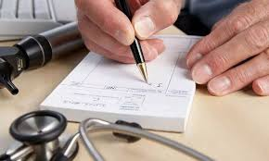
Towards safer prescribing
Written prescriptions should be legible and preferably in full CAPITALS to avoid misinterpretation.
As far as possible prescriptions should be typed and printed to avoid errors.

Slide 19
Towards safer prescribing
Prescribe using generic names
Tailor your prescription to the individual patient
Include the name, dose, route, frequency and duration of every drug the patient is taking.
Ask about recently stopped medications.
Ask about over-the-counter medications, dietary supplements and complementary medicines.
Ask patients if there are any medications they have been advised to take, but do not actually take.
WHO patient safety curriculum guide: multi-professional edition. 2011

Slide 20
Towards safer prescribing
Consider drug–drug and drug–food interactions, medications that can be ceased and medications that may be causing side-effects.
Always include a thorough allergy history
Be very familiar with the medications prescribed
Use reliable, evidence-based sources of information for unfamiliar medications.
Communicate clearly to the patient.
WHO patient safety curriculum guide: multi-professional edition. 2011

Slide 21
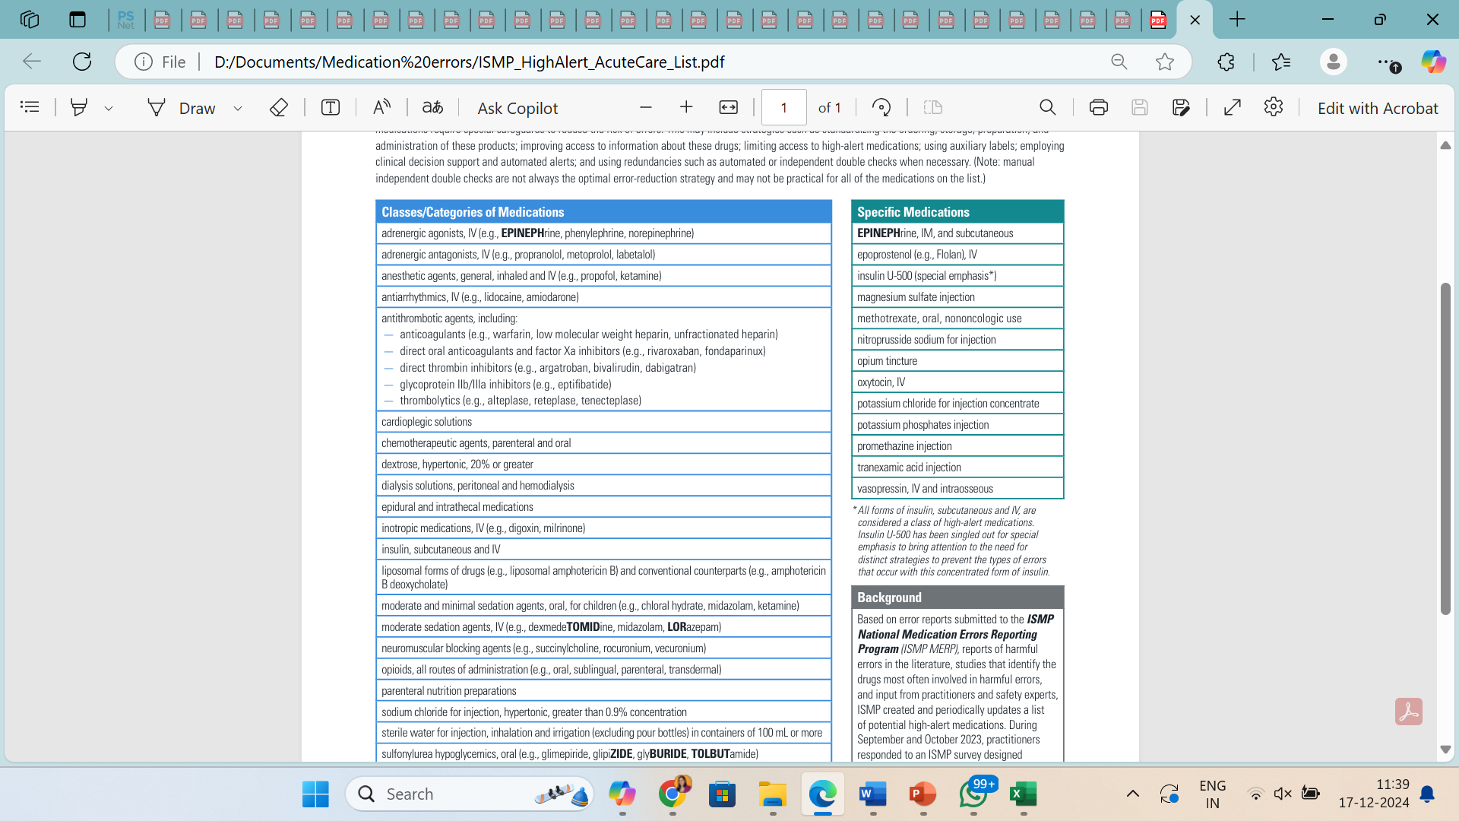
High alert medications
Drugs that bear a heightened risk of causing significant patient harm when they are used in error.
The consequences of an error are clearly more devastating to patients.
ISMP List of High-Alert Medications in Acute Care Settings. ISMP; 2024.

Slide 22
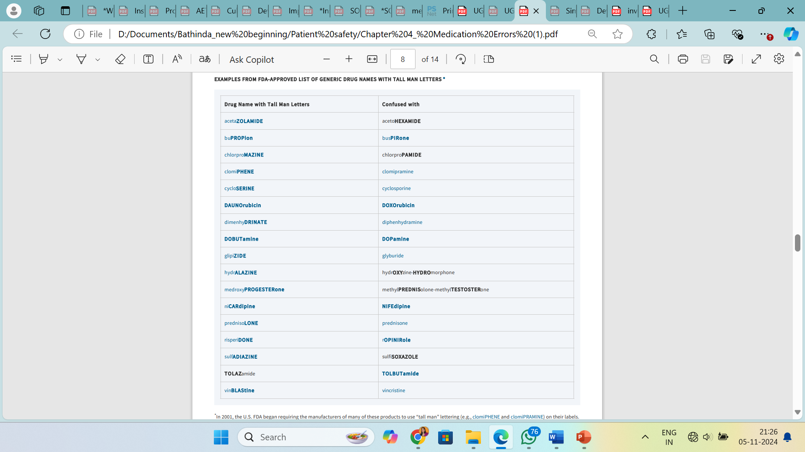
TALLMAN lettering for similar drug names

Slide 23
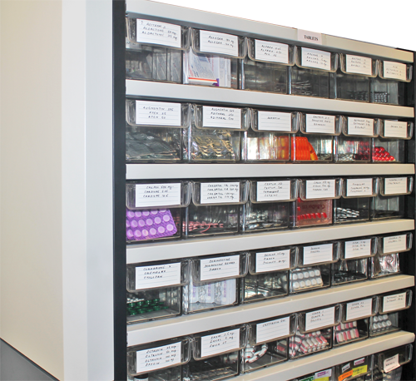
Storage of medications
Organize the workplace
Take the time to store drugs properly
Be mindful of optimum storage temperature of medicines

Slide 24

Sound-alike drugs
Glynase Glyburide8 | Zinase Serratiopeptidse*
Diamox Acetazolamide* | Zimox Amoxycillin*
Inderal Propranolol* | Incidal Cetirizine*
* Generic name

Slide 25
Look-alike drugs
Lasix Furosemide* | Avil Pheniramine*
Zyloric Allopurinol* | Buscopan Hyoscine*
Pantum Pantoprazole* | Veltam Tamsulosin*
*Generic name

Slide 26
Reduce dispensing errors
Confirm that the prescription is correct and complete
Be careful with zeros and abbreviations;
Reduce distraction when possible;
Focus on reducing stress and balancing heavy workloads;
Always provide thorough patient counseling
WHO patient safety curriculum guide: multi-professional edition. 2011

Slide 27
Medication reconciliation
Comparing a patient’s current medication orders to all of the medications that the patient had been taking before any care transition (hospital admission, transfer, or discharge).
Steps involved:
Determine current list of medications
Develop a list of medications to be prescribed
Compare the two lists, make clinical decisions
Finalize the list, and communicate to patient.

Slide 28
Safeguarding drug administration
5 Rs : right drug, right route, right time, right dose and right patient.
Separate storage of LASA and High- risk medication
Labeling all medications before preparing
All medicines and labels to be verified by two qualified nursing professionals before administration
Any medication found to be unlabeled should be discarded immediately
Continuous training on LASA and High-risk medication and Medication Error reporting

Slide 29
Use of Health Information technology to prevent ME
Computerised provider order entry (CPOE)
Allows prescribers to enter, modify, and transmit medication and other orders electronically, typically within a central electronic health record (EHR).
E Prescriptions
ePrescribing involves the electronic ordering and transmission of prescriptions via a standalone or EHR-integrated system.
CDS may exist as standalone knowledge support without ordering functions or be integrated with CPOE or ePrescribing systems.

Slide 30
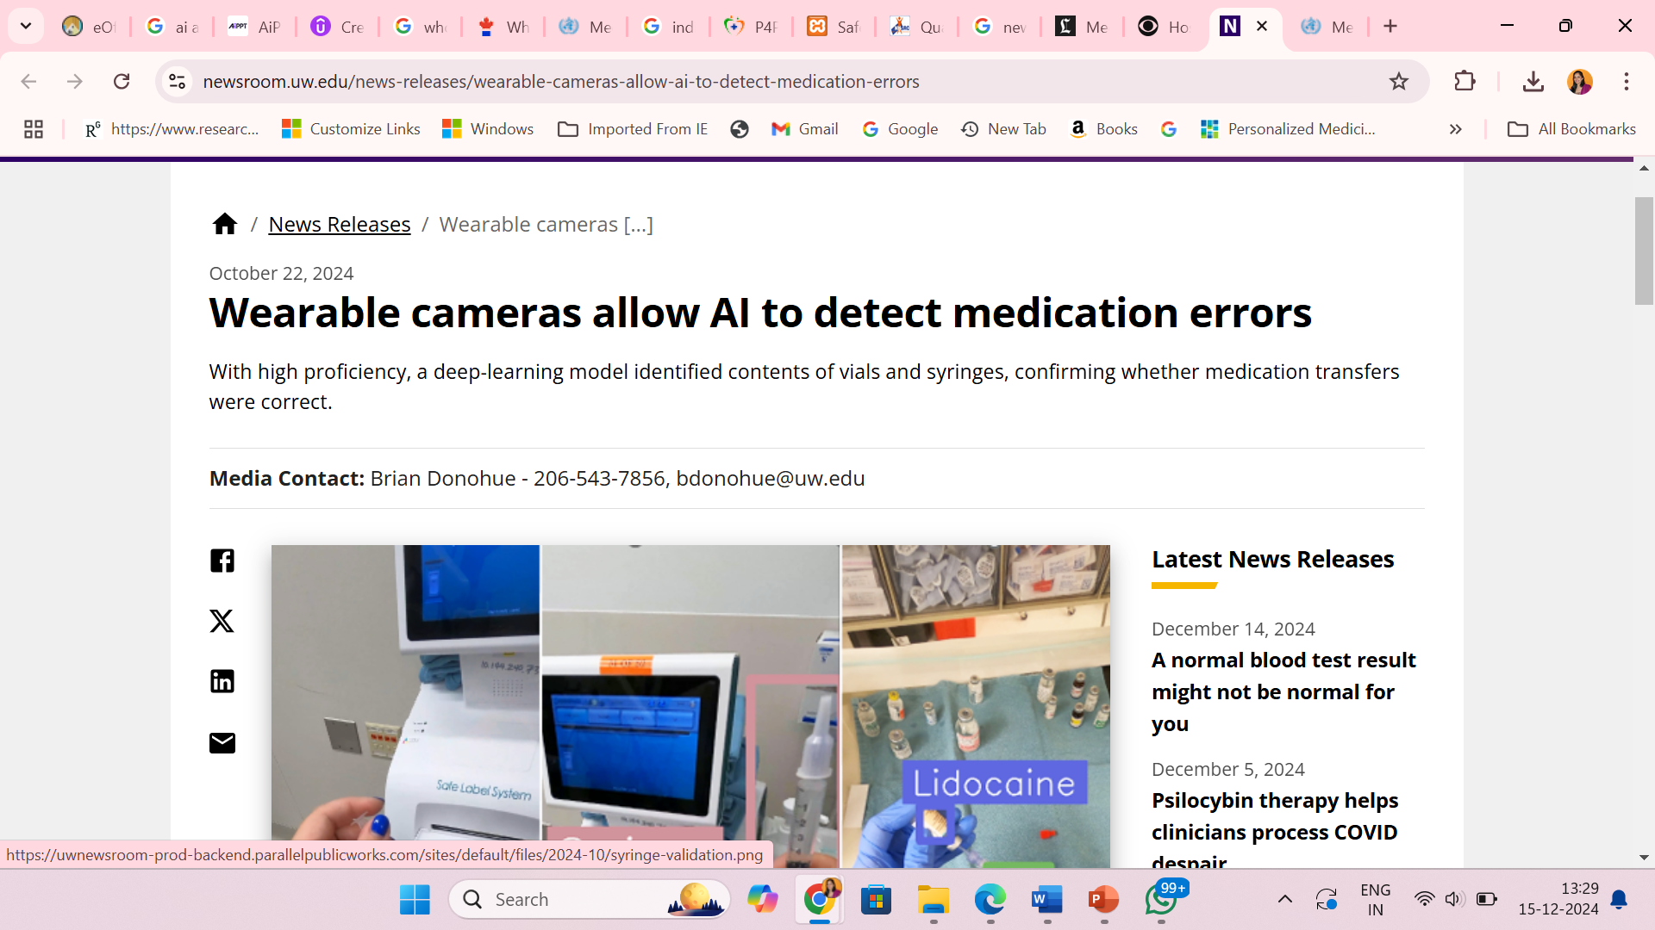
Use of Health Information technology to prevent ME
Automated drug distribution cabinets enabled with bar code scanning
Barcode- assisted medication administration
Smart IV infusion pumps with a two-way interface to an electronic medical record (EMR)

Slide 31

Reporting medication errors
Medication errors should be seen as opportunities to assess practice, find out what went wrong, learn from mistakes, and make changes.

Slide 32
Incident reports
Voluntary reporting of incidents by HCPs, patients or parents of patients.
Reporting can be done using a paper form, by email, telephone or an interactive computer-based mechanism.
Advantage: Easy to implement and generally inexpensive.
Limitation: Under-reporting

Slide 33
Patient chart review
Encompasses concurrent or retrospective medical record review which may also include discharge summaries, pharmacy databases and laboratory data.
The review is conducted by trained healthcare professionals.
Cases are evaluated independently by two or more experts.
Good planning is required for definitions, inclusion criteria, and triggers.

Slide 34
Patient chart reviews
Use: To detect all types of incidents, although it is more useful for detecting ADEs and potential ADEs, mainly those generated in the prescription and monitoring processes.
Less effective in detecting errors in the dispensing and administration processes.
Challenges: difficulty in training reviewers (nurses, pharmacists, students, research assistants) and the resources needed, both fiscal and human.
The results depend on the quality of documentation and reviewers’ abilities to capture triggers.

Slide 35
Direct observations
This method consists of observation of the administration of medicines at the patient’s own bedside in order to detect any difference between what the patient receives and the medical prescription.
A trained nurse observes drug administration, registers each action, and then compares what was done with the original physician orders.
The observer must be trained and visits different units in sequence.

Slide 36
Direct observations
Use: Reliable and effective method to detect and to quantify the administration errors and is also valuable for the detection of dispensing errors,
Limitations: Not useful to detect errors in the prescription and monitoring processes.

Slide 37
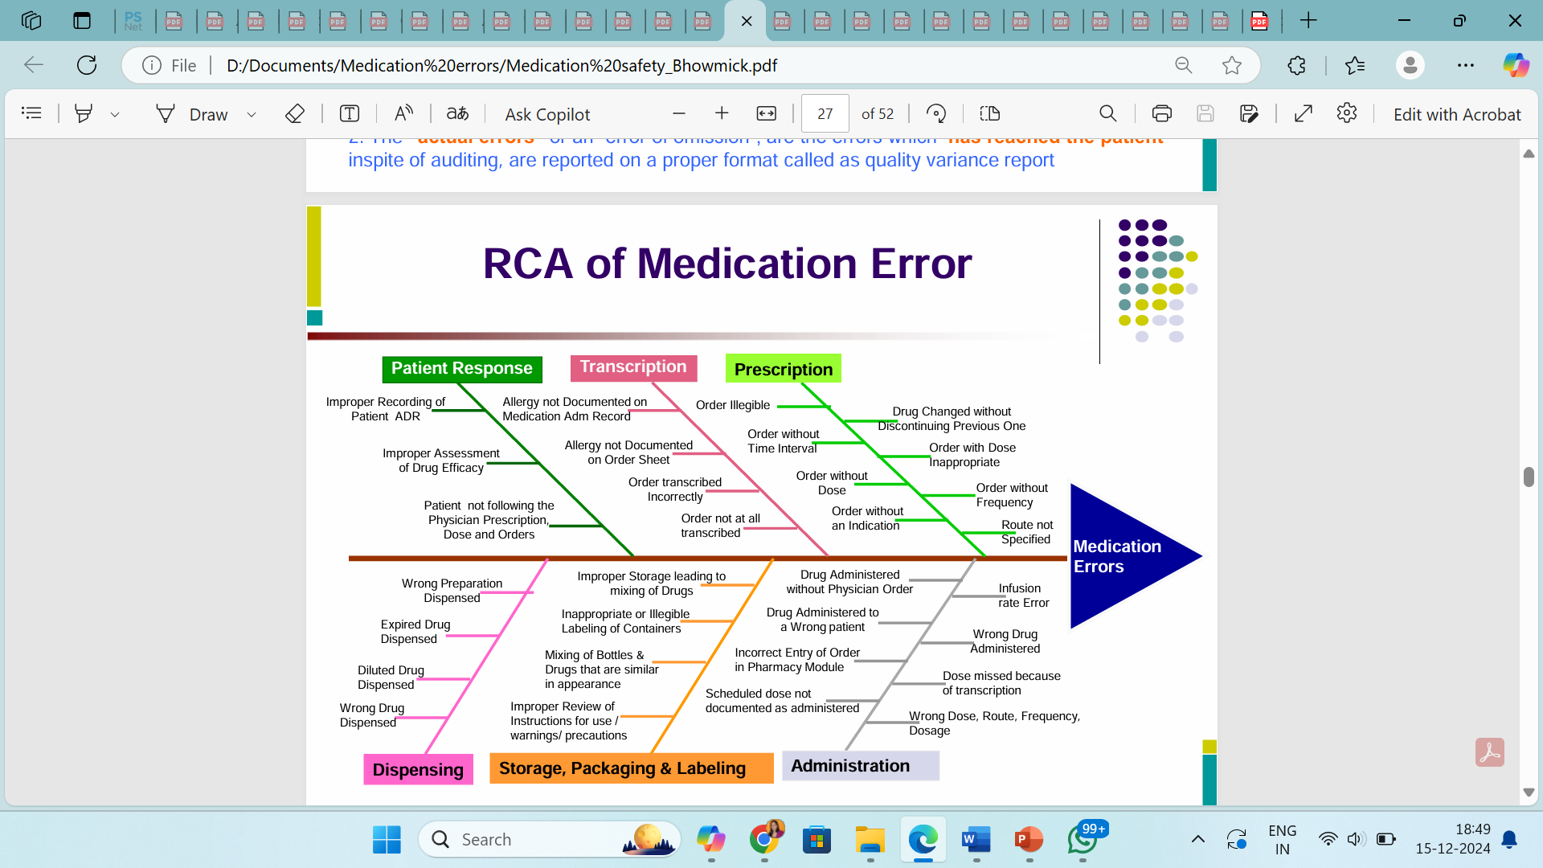
Root cause analysis of medication errors

Slide 38
Giving Patients the tools to be part of the safety system
Expert medication reviews, especially at care transitions.
___________________________________________________
Information on high-risk drugs
___________________________________________________
How to report an adverse drug reaction or medication incident
___________________________________________________
Signs of drug reaction or overdose
___________________________________________________
How to access medication information
___________________________________________________

Slide 39
Take home message
1.Errors happen due to a complex interplay of factors.
2. Establish a culture of safety in the workplace.
3. When an error happens, look for all contributing factors.
4. Strategies to target medication safety need to target multiple points in the process

Slide 40

Safety isn’t expensive, it’s priceless. Anonymous

